Slide 1
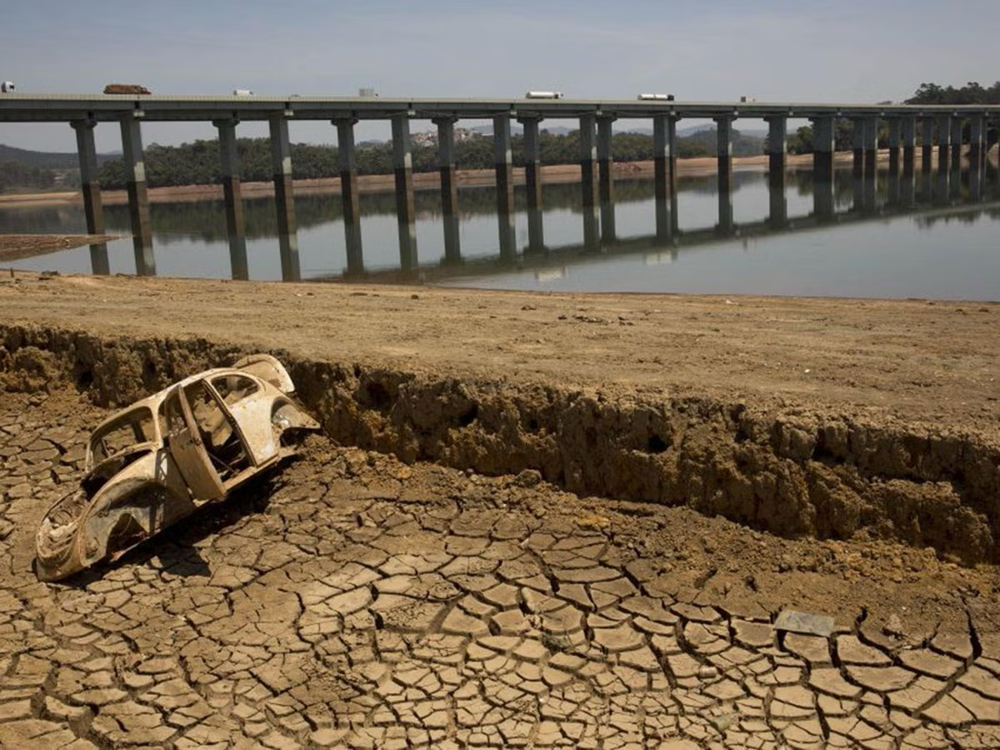


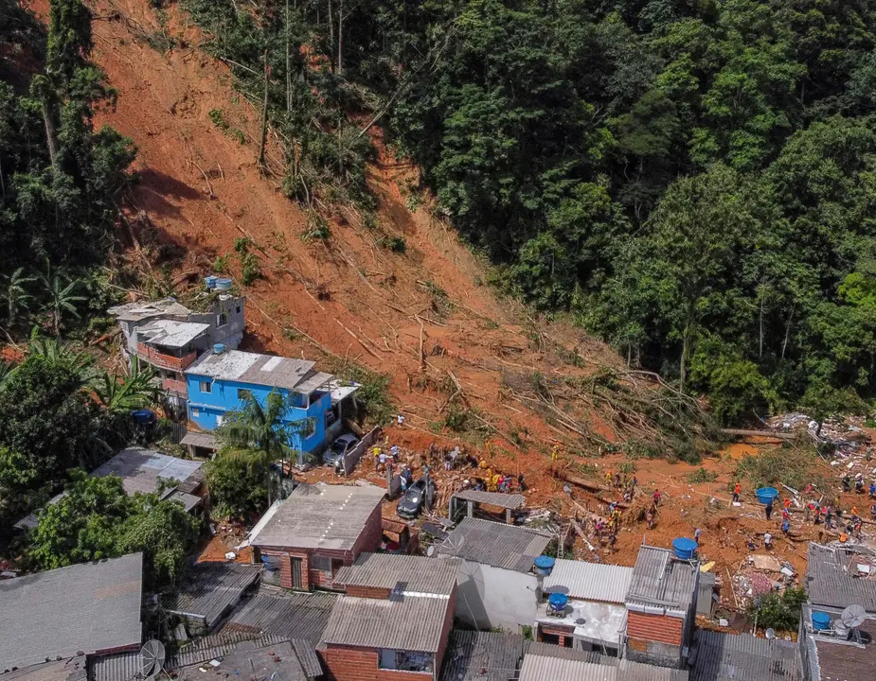
Exploring limits of habitability in Brazil.
Presented by Srishtee Sinha.

Slide 2
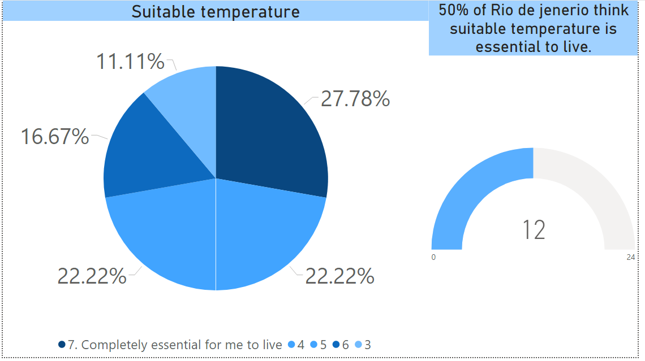
Is suitable temperature essential to live?

Slide 3
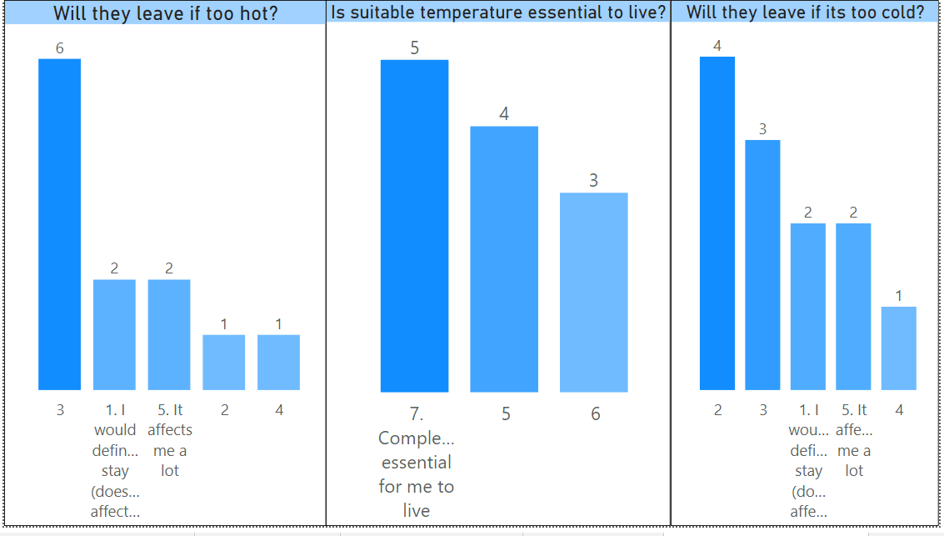
But will they stay or leave based on suitable temperature?

Slide 4
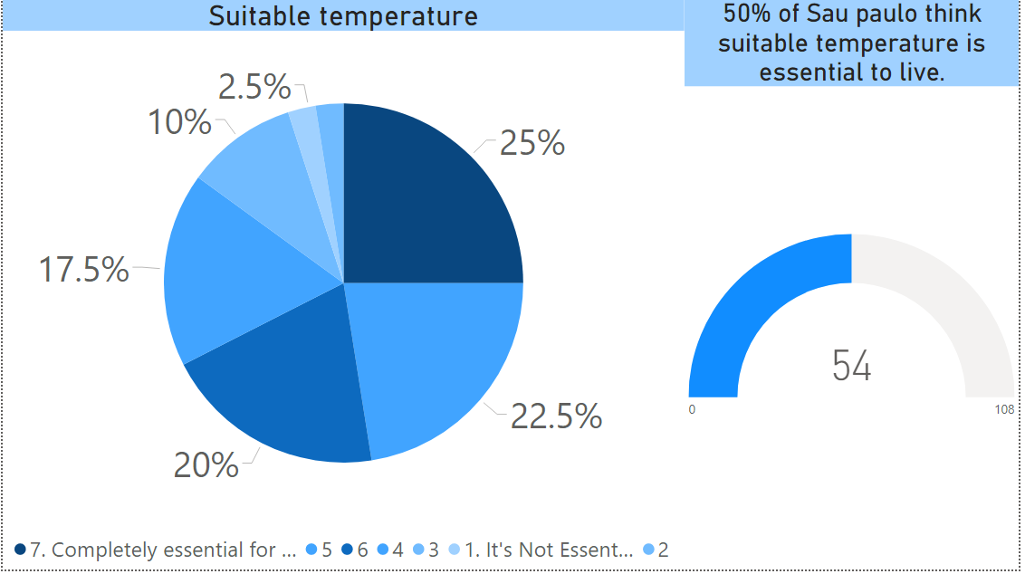
Suitable temperature is essential in Sao Paulo.

Slide 5
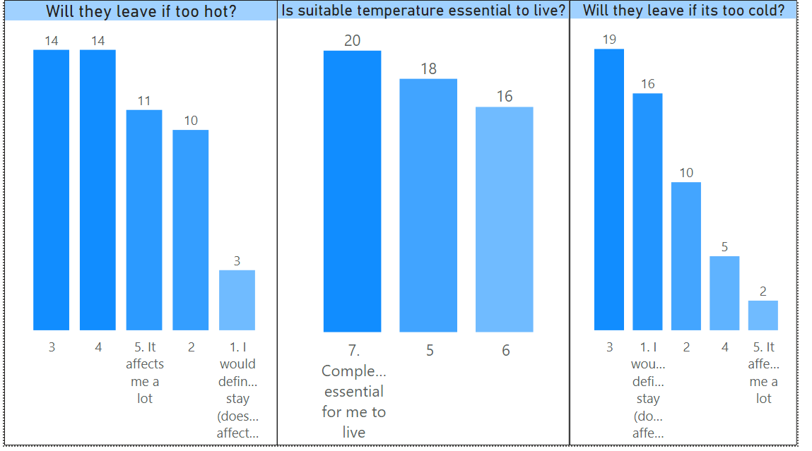
But people might leave if its too hot but not cold.

Slide 6
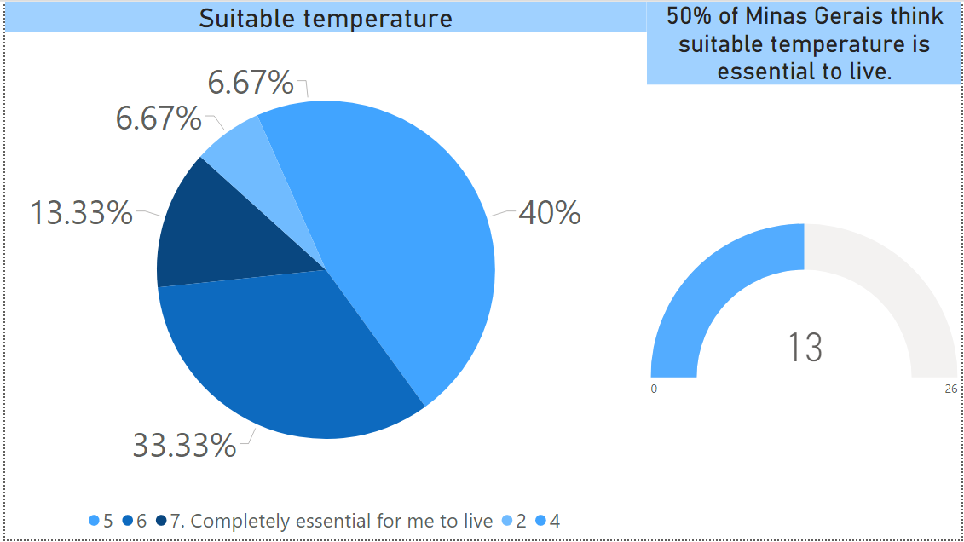
In Minas Gerais.

Slide 7
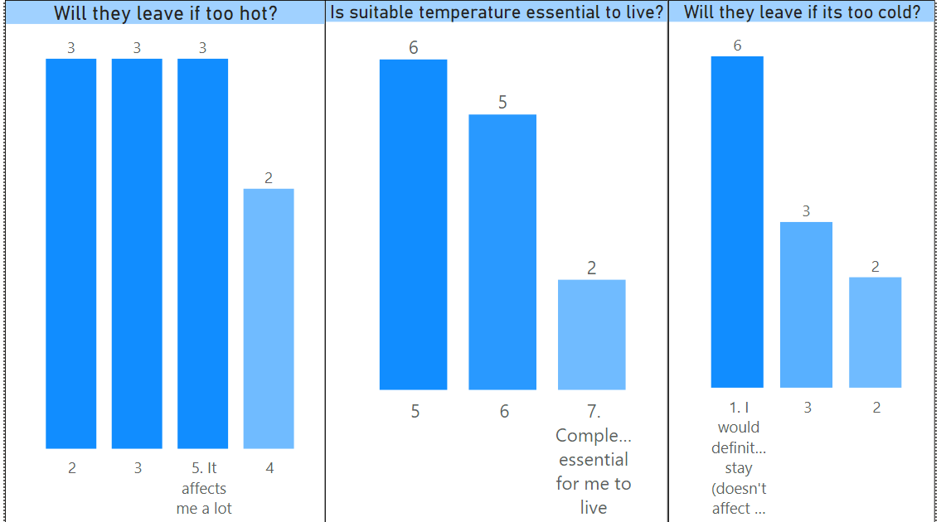
But people might leave if its too hot but not cold.

Slide 8
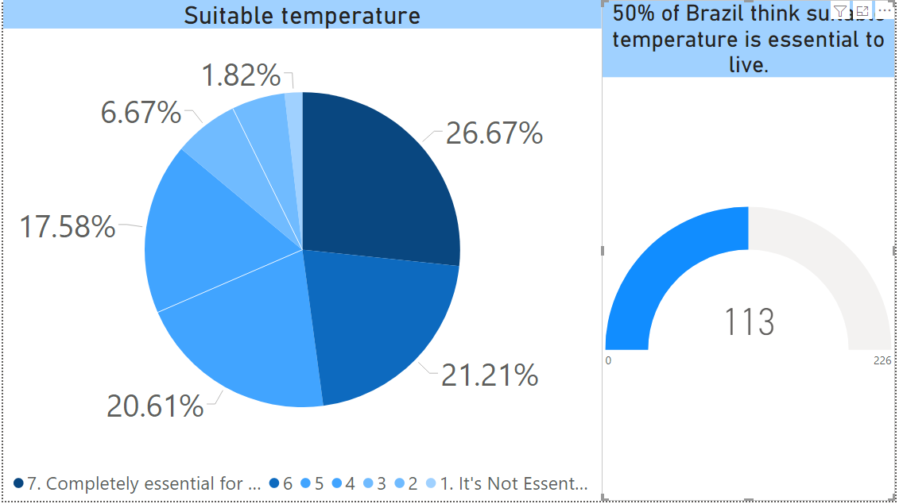
Overall.

Slide 9
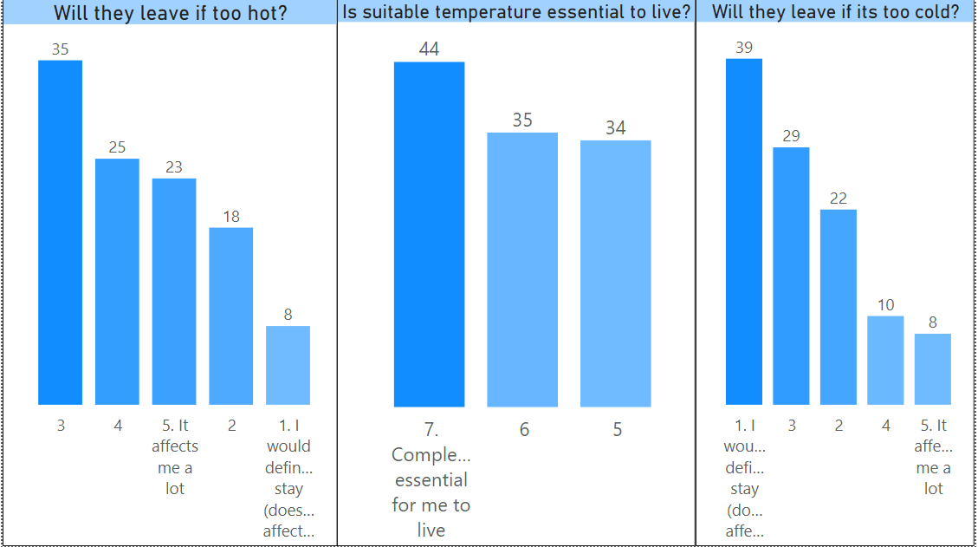
But people might leave if its too hot but not cold.

Slide 10
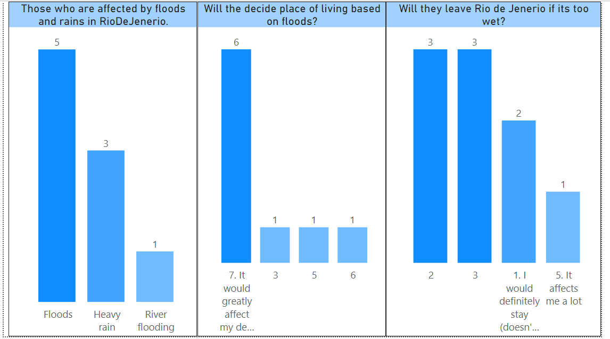
Floods in Rio de Janerio.

Slide 11
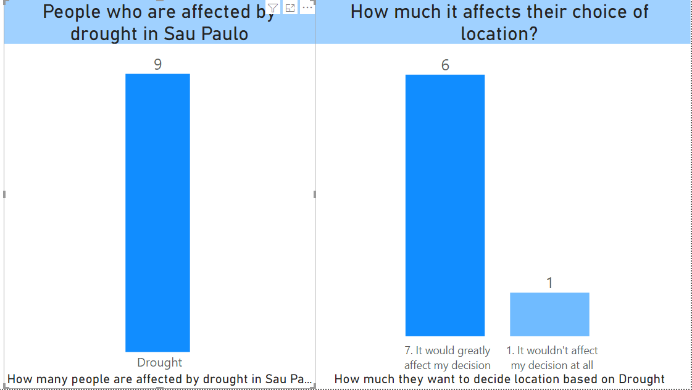
Drought in Sao Paulo.

Slide 12
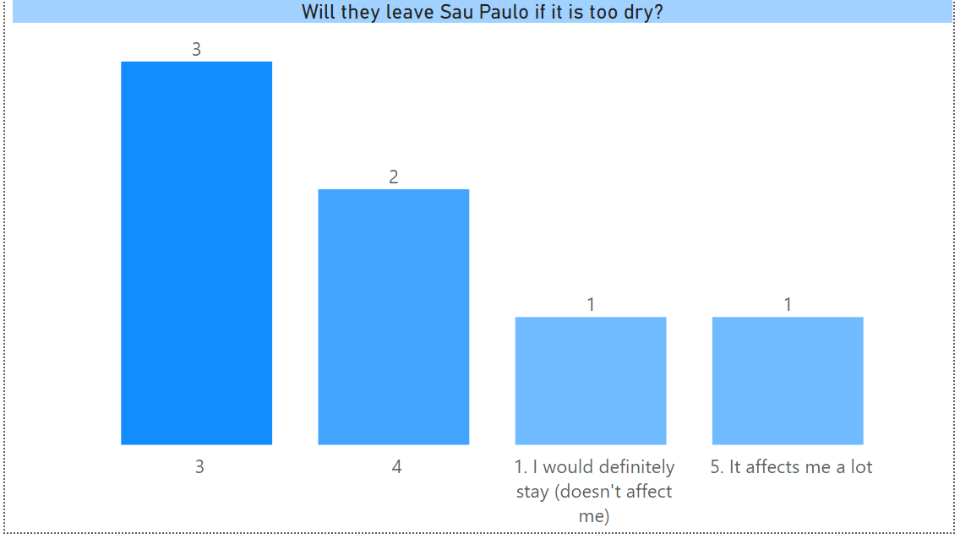
Will they leave Sau Paulo if too dry?

Slide 13
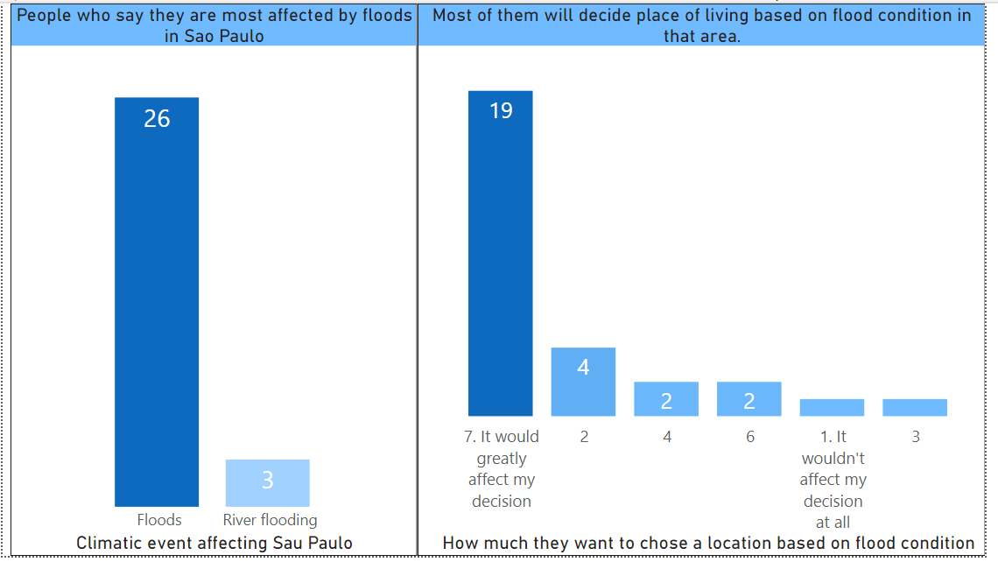
They will decide residence based on flood condition.

Slide 14
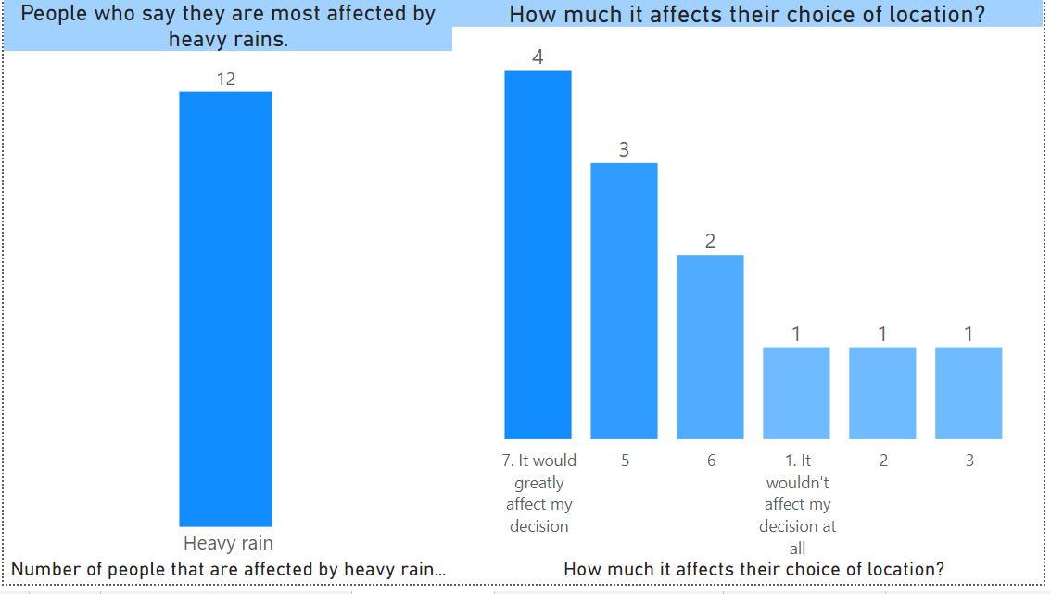
They would also decide place to live based on rainfall.

Slide 15
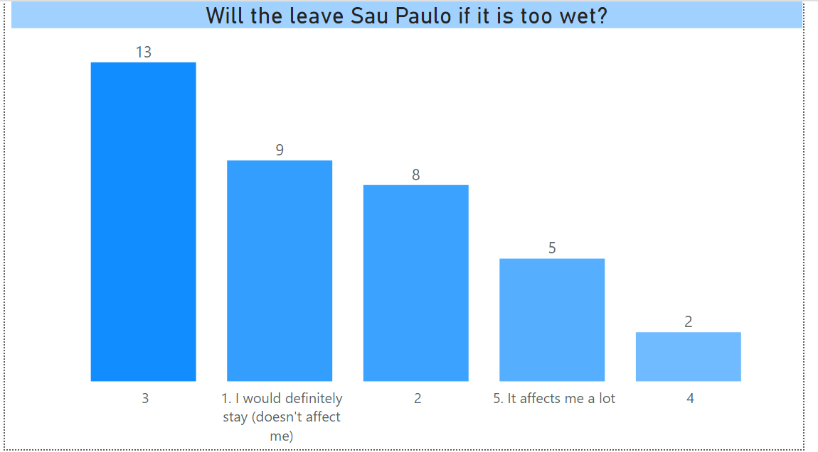
But they won’t relocate if the place is too wet.

Slide 16
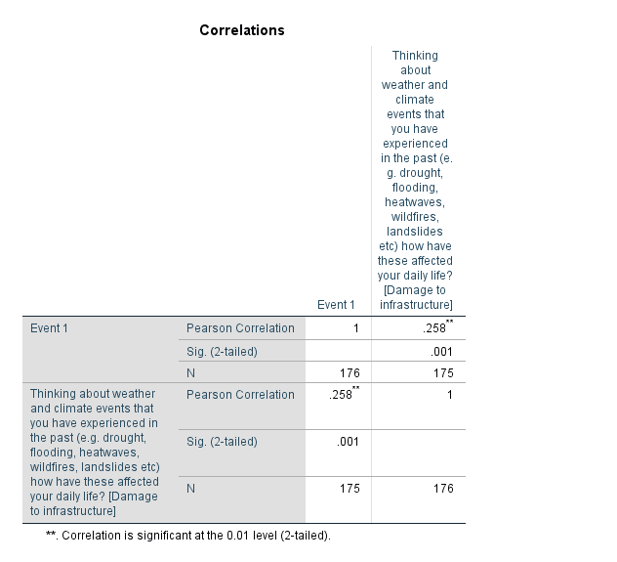
There is some correlation between people who remember climatic event in event 1 and how they have been impacted by damage to infrastructure

Slide 17
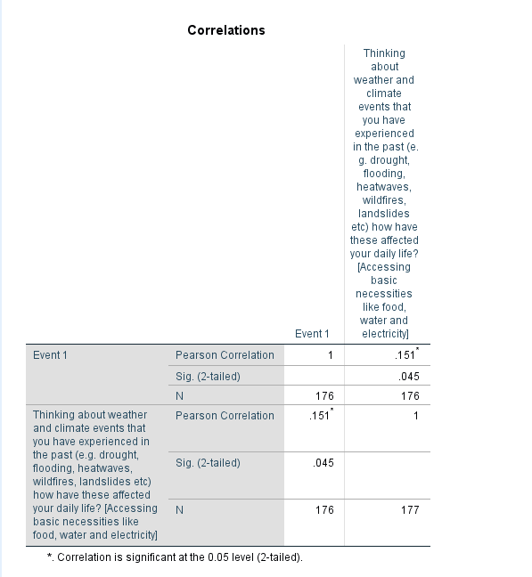
Also, some for access to basic- necessities.

Slide 18
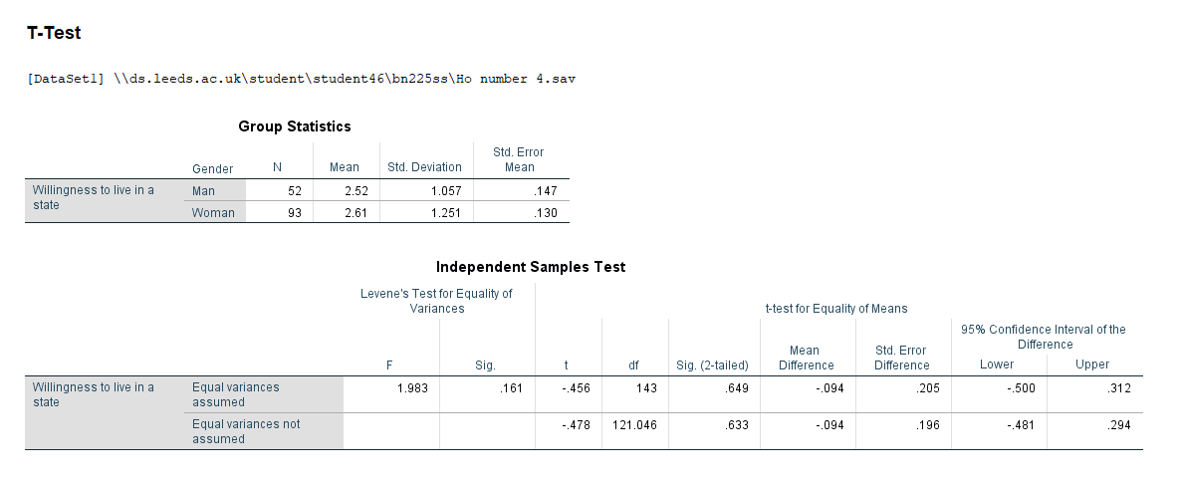
Willingness to live if too wet, is not significantly different for male and female.

Slide 19
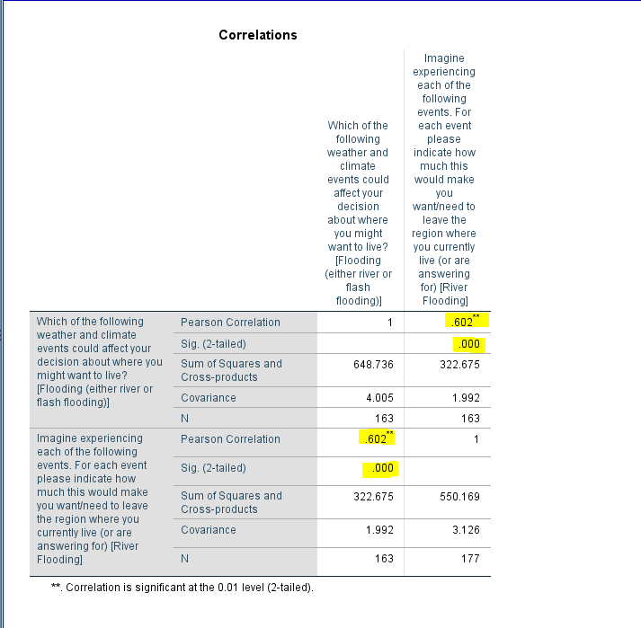
Willingness to leave is positively correlated to willingness to live in case of floods.

Slide 20
Road ahead.
Do people think they are more affected by climatic factors or non-climatic factors? Compare the means of the two impacts.
Those who are affected by climatic factors, how do they think habitability can be improved?
To perform principal component analysis to group the climatic events into logical categories such as “Too hot” “Too wet” and “Too dry” for factors affecting willingness to live and willingness to leave.
Comparing the means of willingness to live and willingness to leave.
Performing repeated measures ANOVA for all 8 climatic events to compare the impacts.
Performing regression to further determine how people consider various factors to decide whether they want to relocate or not.
Logistic regressions to determine if there is a relationship between the factors affecting them and events they remember.

Slide 21
Hypothesis to test. (H0)
There is no significant relationship between the climatic factors affecting people and their willingness to live.
There is no significant relationship between the climatic factors affecting people and the events they remember.
There is no significant relationship between the most affecting factors and gender.
There is no significant relationship between the most affecting climatic factors and age groups.

Slide 22
Thank You!

